Slide 1
Project – 1 *Data acquisition and Data wrangling
Libraries to be used :-
*Pandas – high-level data manipulation tool
NumPy – working with multidimensional arrays
Matplotlib – provide wide variety of functions for creating static, interactive and animated visualization
Seaborn – used for statistics purpose

Slide 2
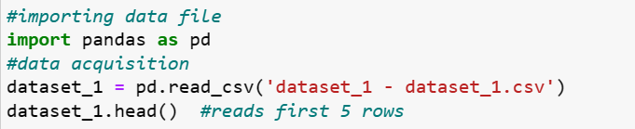
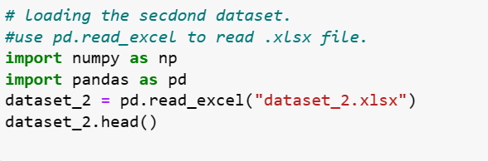
Importing csv. and excel file using pandas libraries

Slide 3
Data wrangling or merging files. * After loading the dataset we needed to merge Both the files * After merging the files we use some function to check and edit the incorrect rows and columns and to remove unwanted rows and columns * There are some functions given below which used to merge and manipulate data easily.

Slide 4
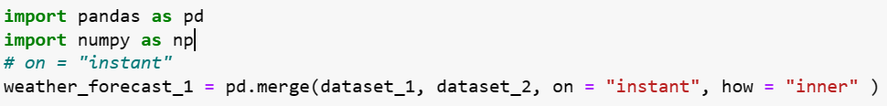
After merging we check the shape of the data which gives number of rows and columns of the data for eg:- merged_data.shape – gives exact rows and columns merged_data.head – gives first five data’s of the dataset merged_data.tail – gives the last five data’s of the dataset merged_data.column – gives the index and headings of the data’s merged_data.info – gives details of the columns, data types and non-null counts of the dataframe

Slide 5
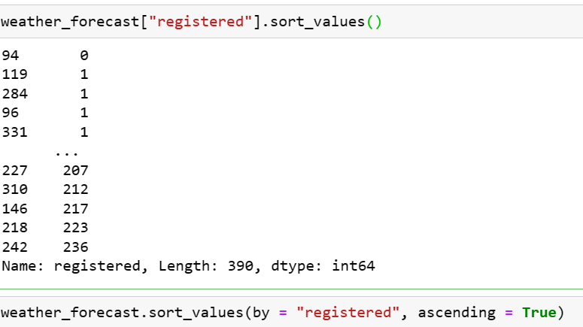
To sort values in each columns in ascending or descending manner. * data_set[“col”].sort_values * data_set.sort_values(by =“col”,ascending = true)

Slide 6
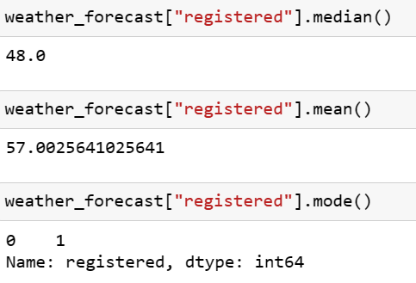
How to calculate mean, median, mode
In Python, you can calculate these measures using the statistics module for simple lists of numbers, or using the numpy library for more complex arrays and matrices.
In Python, we can calculate the mean using the statistics module for simple lists of numbers, or using the NumPy library for more complex arrays and matrices. Here's an example of how to calculate the mean, median and mode using both methods:

Slide 7
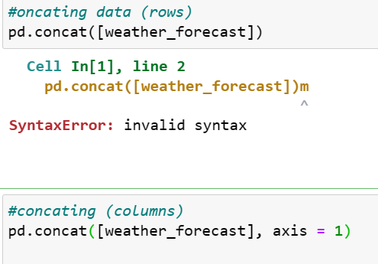
Concating data
Concatenating data in Python refers to the process of combining two or more datasets along a particular axis. This can be done with various data structures such as lists, arrays, data frames, or series, depending on the libraries being used.

Slide 8
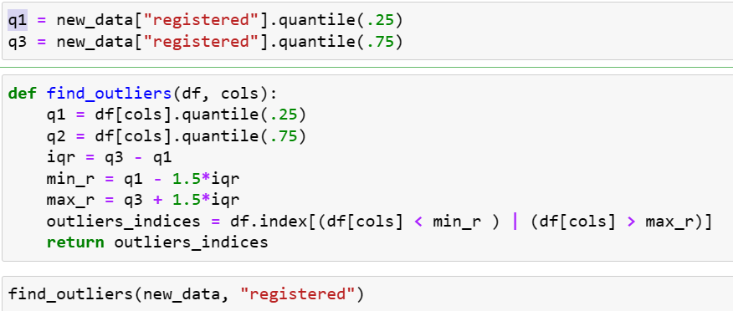
Finding outliers
In statistics, an outlier is a data point that significantly differs from other observations in a dataset. Outliers can occur due to measurement or recording errors, or they may represent genuine but rare events. Identifying and handling outliers is an important part of data analysis, as they can have a significant impact on statistical measures and machine learning models.

Slide 9
Matplotlib library and seaborn
Seaborn is a Python visualization library based on matplotlib that provides a high-level interface for creating informative and attractive statistical graphics. It is built on top of matplotlib and closely integrated with pandas data structures, making it particularly well-suited for visualizing datasets from dataframes.
It seems like you're referring to the matplotlib library in Python. matplotlib is a popular plotting library that provides a wide variety of functions for creating static, interactive, and animated visualizations in Python.

Slide 10

Correlation
In statistics, correlation refers to the measure of the strength and direction of the relationship between two variables. It indicates how much one variable changes when the other variable changes. The correlation coefficient, often denoted by "r", is used to quantify the degree to which two variables are linearly related.

Slide 11
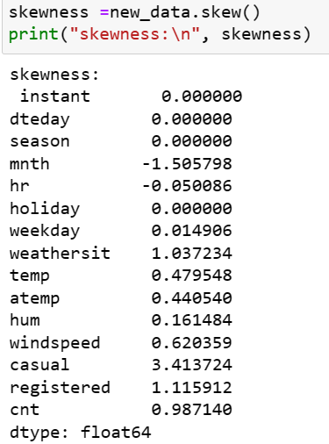
Skewness
Skewness is a measure of the asymmetry of the probability distribution of a real-valued random variable. In a given dataset, skewness measures the lack of symmetry in the distribution of the data points.

